Slide 1

Computer Fundamentals
By Krishna Chakravarty
Associate Professor
KIIT Deemed to be University

Slide 2
contents
Day 2
Generations of computer
Classification of computer
Anatomy of computer
Hardware
Input devices
Output devices
CPU
Memory Unit
Software
Units of memory

Slide 3
Topic 1 Generation of computers

Slide 4
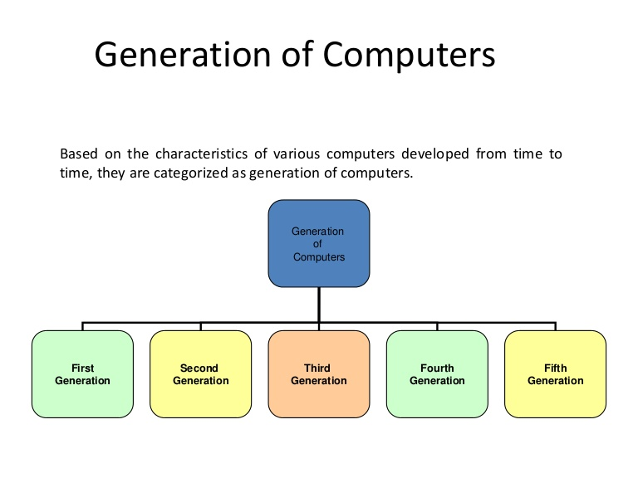
Generation of computers
Generation in computer terminology is a change in technology a computer is/was being used.
Initially, the generation term was used to distinguish between varying hardware technologies.
Nowadays, generation includes both hardware and software, which together make up an entire computer system..

Slide 5
Generation of computers
Gen # | Technology | Operating System | Year of Introduction | Specific Computers
1 | Vacuum Tube | None | 1945 | Mark1
2 | Transistor | None | 1956 | IBM 1401, ICL 1901, B5000, MINSK-2
3 | SSI and MSI (circuit based) | Yes | 1964 | IBM S/360/370, UNIVAC 1100, HP 2100A, HP 9810
4 | LSI and VLSI (micro processor based) | Yes | 1971 | ICL 2900, HP 9845A, VAX 11/780, ALTAIR 8800, IBM PC
5 | HAL | Yes | Present and beyond

Slide 6
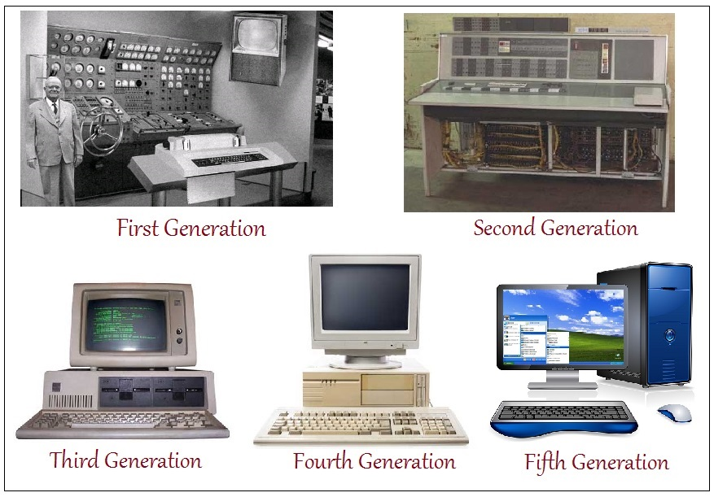
FIVE generations of computers

Slide 7
Topic 2 Classification of computers

Slide 8
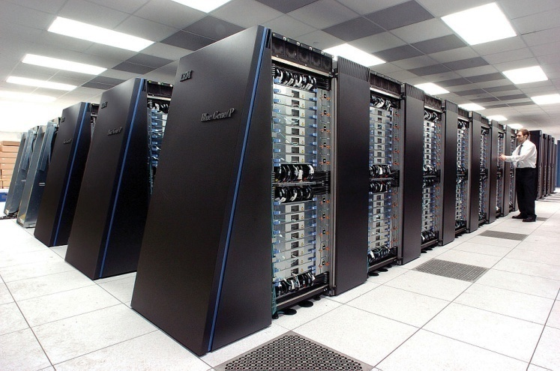
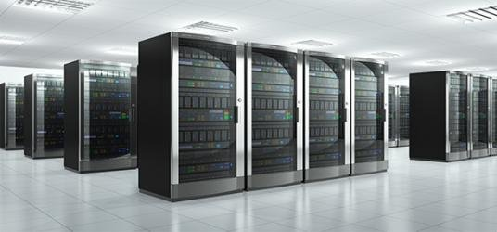
CLASSIFICATION of computers
S.No | Type | Specifications
1 | Super computer | It is an extremely fast computer, most expensive. Can execute hundreds of millions of instructions per second. Used where immense amount of mathematical calculations are there like weather forecasting Nuclear energy research Petroleum exploration | The IBM Blue Gene/P supercomputer
2 | Main Frame | It is a multi-user computer system, Capable of supporting vast number of users simultaneously. Large in size, expensive Can process large amount of data at very high speed and support many input, output.

Slide 9
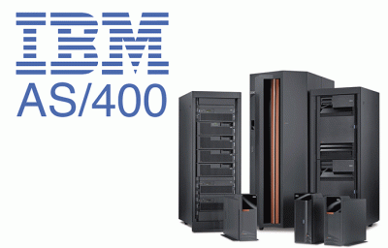
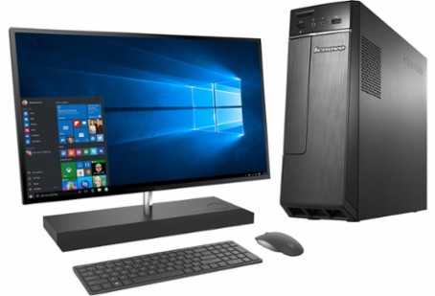
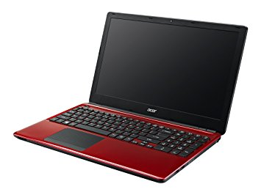
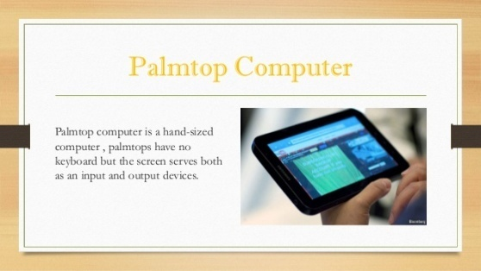
CLASSIFICATION of computers
S.No. | Type | Specifications
3 | Mini Computer | It is a multi-user computer system (10 to 100) Smaller in size and memory capacity. Ex – Digital euqipment corporation VAX, IBM AS/400
2 | Micro computers | Intended for personal need for an individual Desktop – on a desk Laptop – portable Palmtop computer/digital diary/Notebook – no separate key board

Slide 10
Topic 3 ANATOMY of a computer a. hardware A.1. Input A.2. output devices A.3. CPU A.4. memory unit b. software

Slide 11
Five basic operations
S.No. | Operation | Description
1 | Take Input | The process of entering data and instructions into the computer system.
2 | Store Data | Saving data and instructions so that they are available for processing as and when required.
3 | Processing Data | Performing arithmetic, and logical operations on data in order to convert them into useful information.
4 | Output Information | The process of producing useful information or results for the user, such as a printed report or visual display.
5 | Control the workflow | Directs the manner and sequence in which all of the above operations are performed.

Slide 12
Hardware components
Hardware :
physical components of computer that includes all
Mechanical
Electrical
Electronic
And magnetic parts attached to it
HARDWARE components
Input
Central Processing Unit
Memory unit and storage devices
Interface Unit

Slide 13
Topic 3.A.1 input devices

Slide 14
Input devices
Data and instructions are typed, submitted
They are electronic or electromechanical component
Provides means of communicating with computer system for feeding input data and instruction.
Most common input devices
Keyboard
Mouse
Scanner

Slide 15
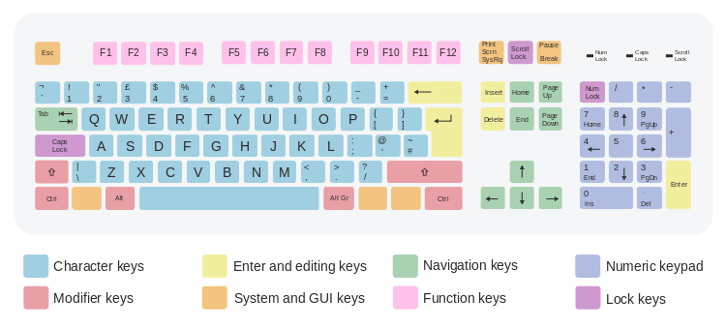
Input devices - keyboard
104 keys
Character keys : Letters, numbers, punctuation marks
Function keys : 12 functional keys, F1 to F12, top of keyboard. They perform different functions depending on operating system or software.
Control keys : Alt, Ctrl, shift, insert, delete, home, end
Navigation keys: Arrows, pg up, pg down
Toggle keys : Scroll lock, Num lock, Caps lock
Miscellaneous key: Insert, delete, escape, print
Key Matrix : Keys are arranged in rows and columns, When a key is pressed, that position sends a signal to the circuit board inside the keyboard, The coordinates x and y of the key is used to determine which key is pressed. Therefore the corresponding data or instruction is identified,

Slide 16
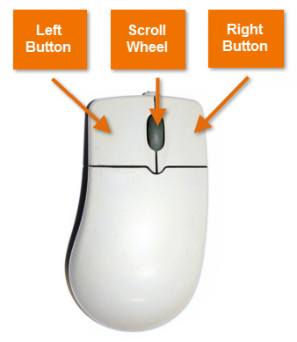
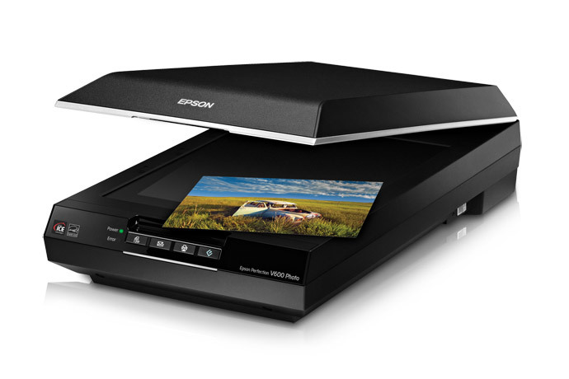
Input devices - MOUSE
MOUSE
It is the pointing device
Moves the cursor around the screen and to point an object (icon, menu, command button etc)
It has commonly 3 buttons.
Mouse tracks the motion of the mouse pointer and senses the clicks and sends them to compute to act accordingly.
It can connect to the system
Through infrared (wireless)
USB connector
SCANNER
Scans picture or document that can be stored.
Stores in storage, can be modified suitably and transported to other computers
Or can be printed on a printer

Slide 17
Topic 3.A.2 output devices

Slide 18
Output devices - monitor
Monitors, commonly called as Visual Display Unit (VDU), are the main output device of a computer. Flat-Panel Display Monitor
Monitor
Viewing screen
CRD
(Cathode Ray Tube)
Flat-Panel Display Monitor
Emissive Displays
(LED)
Non-Emissive Displays
(LCD)

Slide 19
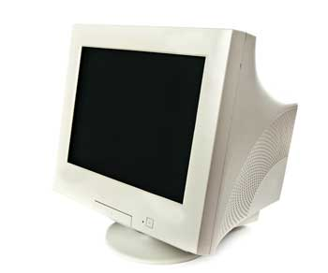

Output devices - monitor
Cathode-Ray Tube (CRT) Monitor
The CRT display is made up of small picture elements called pixels. The smaller the pixels, the better the image clarity or resolution. It takes more than one illuminated pixel to form a whole character, such as the letter ‘e’ in the word help.
A finite number of characters can be displayed on a screen at once. The screen can be divided into a series of character boxes - fixed location on the screen where a standard character can be placed.
There are some disadvantages of CRT −
Large in Size
High power consumption
Composed of vacuum glass tube which is narrowed at one end.

Slide 20
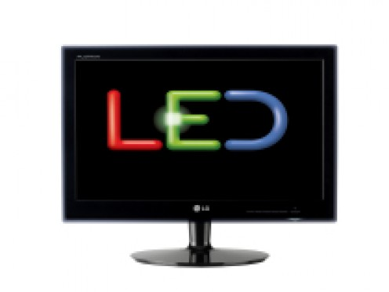
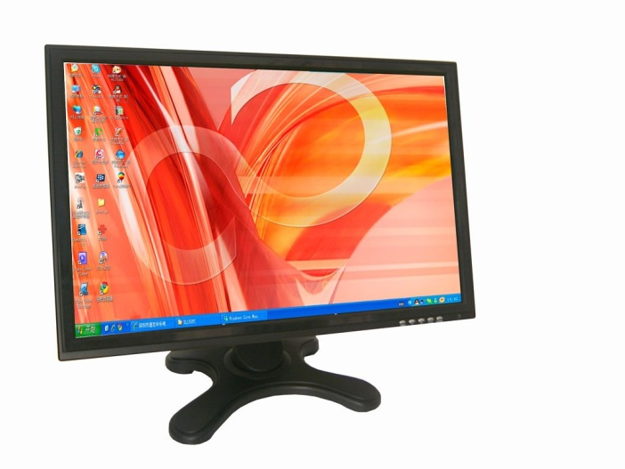
Output devices - monitor
Flat-Panel Display Monitor
The flat-panel display refers to a class of video devices that have reduced volume, weight and power requirement in comparison to the CRT. You can hang them on walls or wear them on your wrists. Current uses of flat-panel displays include calculators, video games, monitors, laptop computer, and graphics display.
The flat-panel display is divided into two categories −
Emissive Displays − Emissive displays are devices that convert electrical energy into light. For example, plasma panel and LED (Light-Emitting Diodes).
Non-Emissive Displays − Non-emissive displays use optical effects to convert sunlight or light from some other source into graphics patterns. For example, LCD (Liquid-Crystal Device).

Slide 21
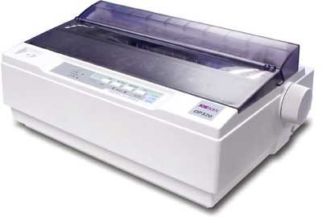
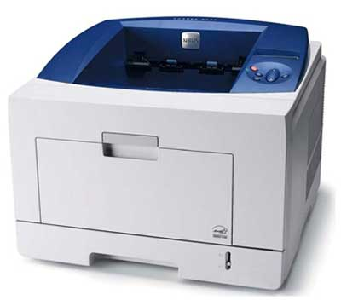
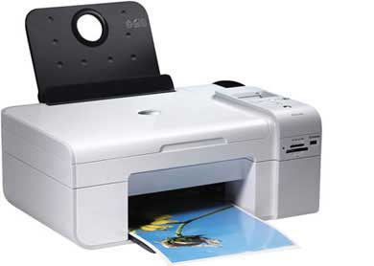
Output devices - Printer
Printer
Printer is an output device, which is used to print information on paper.
Information can contain data, report, document, picture, diagrams.
There are two types of printers −
Impact Printers
Non-Impact Printers
Impact Printers
Impact printers print the characters by striking them on the ribbon, which is then pressed on the paper.
Characteristics of Impact Printers are the following −
Very low consumable costs
Very noisy
Useful for bulk printing due to low cost
There is physical contact with the paper to produce an image
Example : Dot Matrix printer
Non-impact Printers
Non-impact printers print the characters without using the ribbon. These printers print a complete page at a time, thus they are also called as Page Printers.
These printers are of two types −
Laser Printers (use laser lights to produce the dots)
Inkjet Printers (spraying small drops of ink onto paper)
Characteristics of Non-impact Printers
Faster than impact printers
They are not noisy
High quality
Supports many fonts and different character size

Slide 22
Topic 3.A.3 Central Processing unit (CPU)

Slide 23
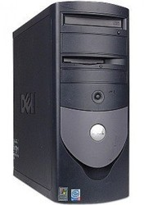
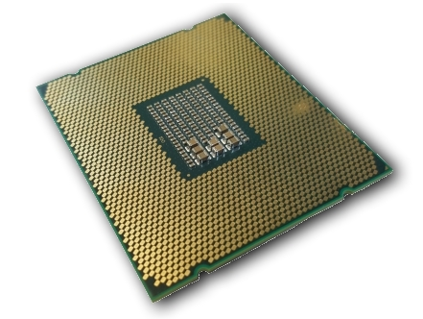
Central processing unit (CPU)
Central Processing Unit (CPU) consists of the following features −
CPU is considered as the brain of the computer.
CPU performs all types of data processing operations.
It controls the operation of all parts of the computer.
Physically it is an integrated circuit silicon chip, mounted on a small square plastic slab, surrounded by metal pins.
Different functional units of CPU
High speed storage devices
Serves some special purpose , like IR – instruction register holds current instructions being executed
This unit consists of two subsections namely,
Arithmetic Section : Function of arithmetic section is to perform arithmetic operations like addition, subtraction, multiplication, and division
Logic Section: Function of logic section is to perform logic operations such as comparing, selecting, matching, and merging of data.
Registers
Arithmetic Logic Unit (ALU)

Slide 24
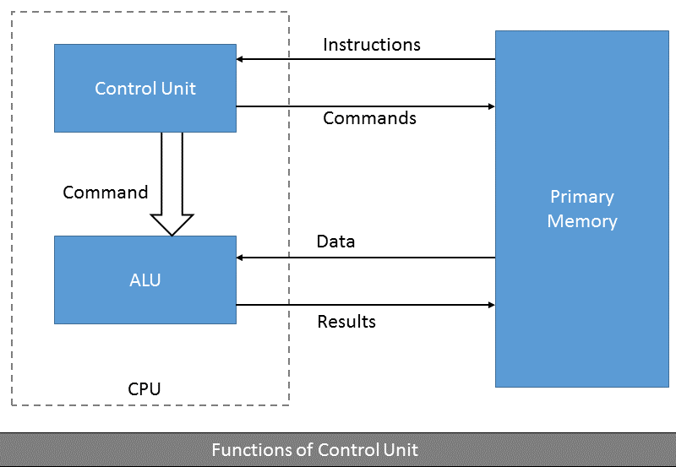
Central processing unit (CPU)
This unit controls the operations of all parts of the computer but does not carry out any actual data processing operations.
Functions of this unit are −
It is responsible for controlling the transfer of data and instructions among other units of a computer.
It manages and coordinates all the units of the computer.
It obtains the instructions from the memory, interprets them, and directs the operation of the computer.
It communicates with Input/Output devices for transfer of data or results from storage.
It does not process or store data.
Control Unit

Slide 25
Topic 3.A.4 memory unit

Slide 26
Memory unit
It is used to store data and instructions. Computer memory is the storage space in the computer, where data is to be processed and instructions required for processing are stored.
The memory is divided into large number of small parts called cells. Each location or cell has a unique address,

Slide 27
Memory unit
Memory
Primary memory
Internal Processor memory
Secondary Memory
Read Only Memory (ROM)
Random Access Memory (RAM)
Disk Drive
Tape drive
Static RAM
Dynamic RAM
Cache
Floppy
Hard disk
CD rom
MROM
PROM
EPROM
EEPROM

Slide 28
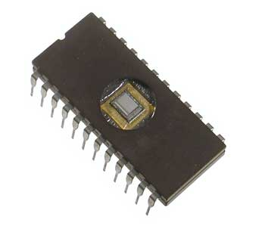
Primary (main) memory | Primary memory holds only those data and instructions on which the computer is currently working. It is the working memory of the computer. Faster than secondary memories. A computer cannot run without the primary memory. It is generally made up of semiconductor device. It is divided into two subcategories RAM and ROM.
 | A. ROM ROM stands for Read Only Memory. The memory from which we can only read but cannot write on it. This type of memory is non-volatile. The information is stored permanently in such memories during manufacture. A ROM stores such instructions that are required to start a computer. This operation is referred to as bootstrap. MROM (Masked ROM) The very first ROMs were hard-wired devices that contained a pre-programmed set of data or instructions.

Slide 29
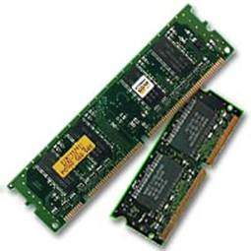
Memory unit
 | Characteristics
Primary (main) memory | PROM (Programmable Read Only Memory) PROM is read-only memory that can be modified only once by a user. EPROM (Erasable and Programmable Read Only Memory) EPROM can be erased by exposing it to ultra-violet light for a duration of up to 40 minutes. Data can be written electrically. EEPROM (Electrically Erasable and Programmable Read Only Memory) EEPROM is programmed and erased electrically. It can be erased and reprogrammed about ten thousand times. Both erasing and programming take about 4 to 10 ms (millisecond). B. RAM RAM (Random Access Memory) is the internal memory of the CPU for storing data, program, and program result. It is a read/write memory which stores data until the machine is working. Holds data and instructions waiting to be processed As soon as the machine is switched off, data is erased. Cache .

Slide 30
Memory unit - RAM
Primary (main) memory | RAM
Static RAM (SRAM) | Dynamic RAM (DRAM)
Memory retains its contents as long as power is being supplied. | DRAM, unlike SRAM, must be continually refreshed in order to maintain the data. This is done by placing the memory on a refresh circuit that rewrites the data several hundred times per second
SRAM need not be refreshed on a regular basis. Long life. | Short life, need to be refreshed.
Large size , expensive | Small size, less expensive
SRAM chips use a matrix of 6-transistors and no capacitors. | All DRAMs are made up of memory cells, which are composed of one capacitor and one transistor.

Slide 31
Memory unit
 | RAM | ROM
Definition | Random Access Memory or RAM is a form of data storage that can be accessed randomly at any time, in any order and from any physical location., allowing quick access and manipulation. | Read-only memory or ROM is also a form of data storage that can not be easily altered or reprogrammed.Stores instuctions that are not nescesary for re-booting up to make the computer operate when it is switched off.They are hardwired.
Stands for | Random Access Memory | Read-only memory
Use | RAM allows the computer to read data quickly to run applications. It allows reading and writing. | ROM stores the program required to initially boot the computer. It only allows reading.
Volatility | RAM is volatile i.e. its contents are lost when the device is powered off. | It is non-volatile i.e. its contents are retained even when the device is powered off.
Types | The two main types of RAM are static RAM and dynamic RAM. | The types of ROM include PROM, EPROM and EEPROM.

Slide 32
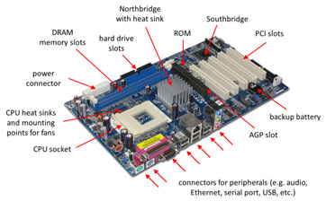
motherboard
The motherboard serves as a single platform to connect all of the parts of a computer together.
It connects the CPU, memory, hard drives, optical drives, video card, sound card, and other ports and expansion cards directly or via cables.
It can be considered as the backbone of a computer.
Motherboard supports a single type of CPU and few types of memories.
Following are the popular manufacturers of the motherboard.
Intel
ASUS
AOpen

Slide 33
Topic 3.B SOFTWARE

Slide 34
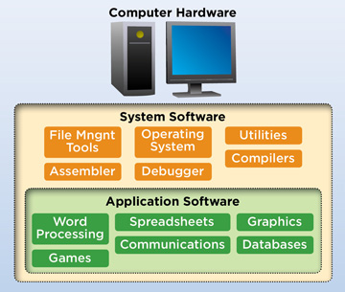
software
Software is a set of programs, which is designed to perform a well-defined function. A program is a sequence of instructions written to solve a particular problem.
There are two types of software −
System Software
Application Software
System Software
The system software is a collection of programs designed to operate, control, and extend the processing capabilities of the computer itself.
System software is generally prepared by the computer manufacturers.
Some examples of system software are Operating System, Compilers, Interpreter, Assemblers, etc.
Application Software
Application software products are designed to satisfy a particular need of a particular environment.
Application software may consist of a single program, such as Microsoft's notepad for writing and editing a simple text. It may also consist of a collection of programs, often called a software package, which work together to accomplish a task, such as a spreadsheet package.
Examples of Application software are the following −
Payroll Software, Student Record Software

Slide 35
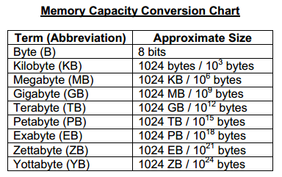
Units of memory
Memory unit is the amount of data that can be stored in the storage unit. This storage capacity is expressed in terms of Bytes.
The following table explains the main memory storage units −
S.No. | Unit & Description
1 | Bit (Binary Digit) A binary digit is logical 0 and 1 representing a passive or an active state of a component in an electric circuit.
2 | Nibble A group of 4 bits is called nibble.
3 | Byte A group of 8 bits is called byte. A byte is the smallest unit, which can represent a data item or a character.

